Slide 1
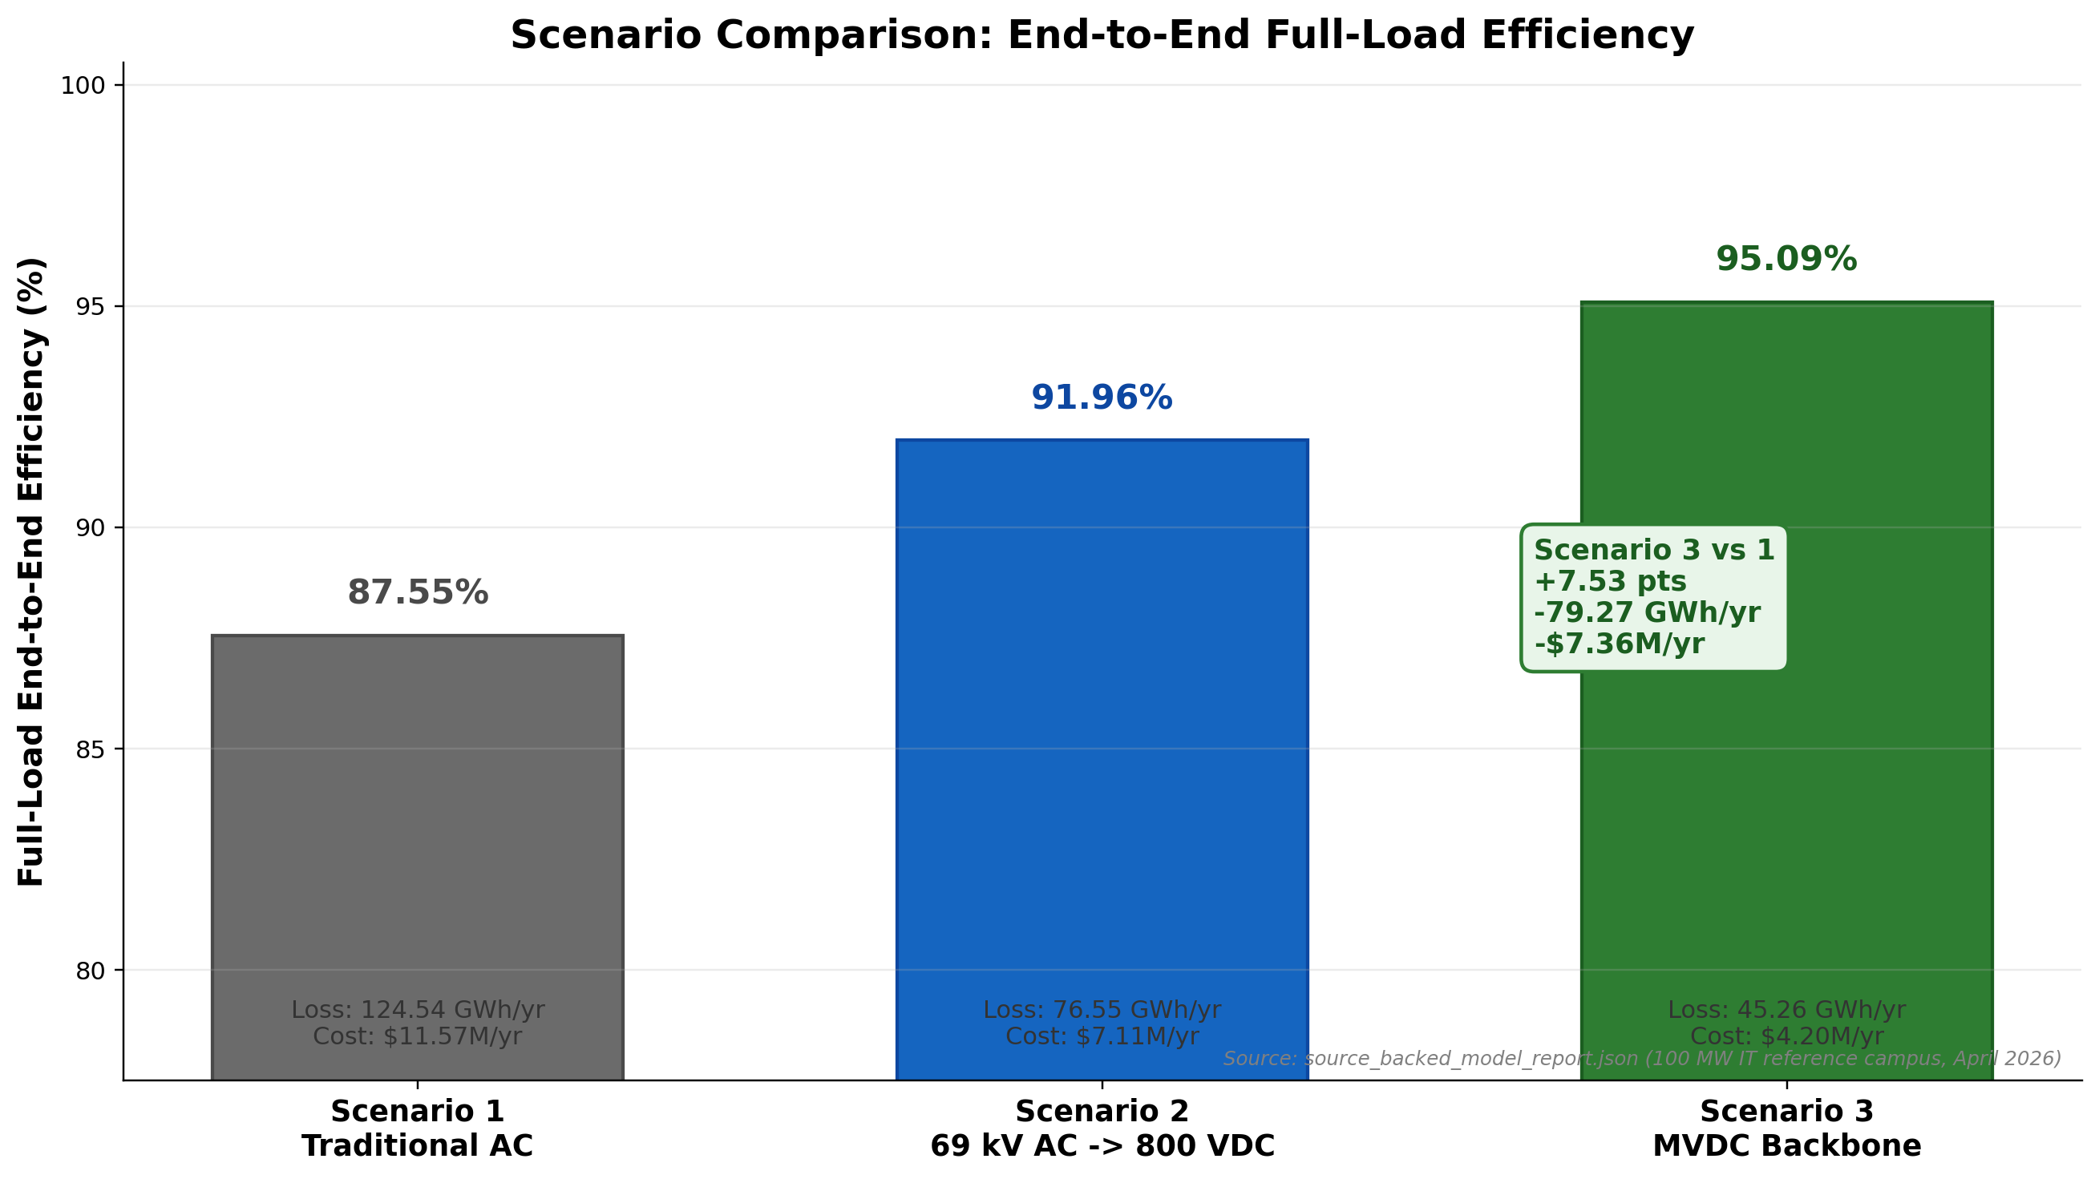
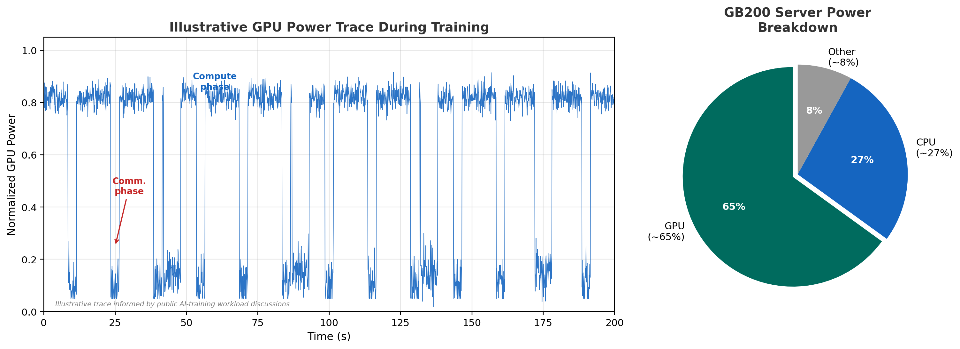
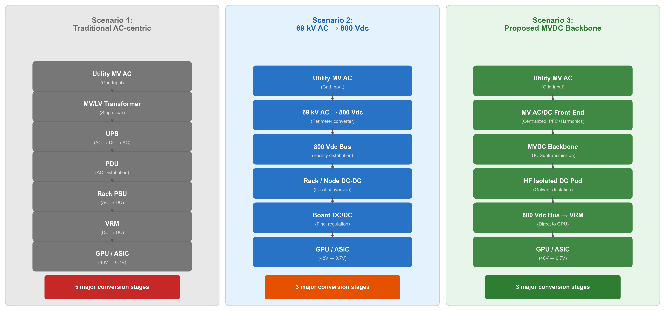
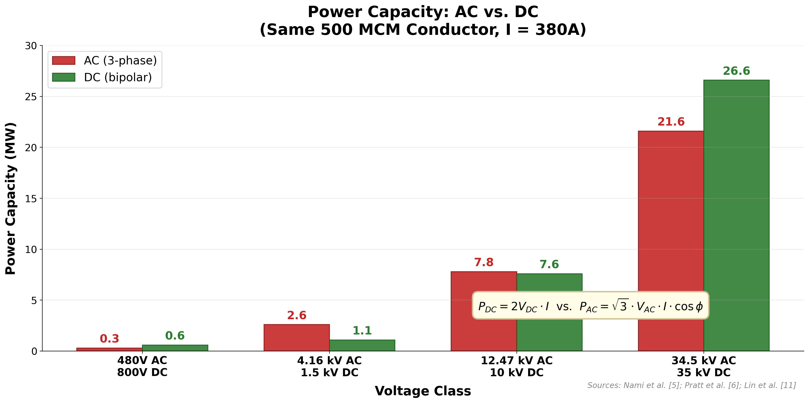
Direct Current (DC) Subtransmission Backbone for AI Factories
From Utility AC to 800 Vdc GPU Rails: Architecture, Efficiency, and Power Quality
Jane Yang (yjane@stanford.edu) Liang Min (liangmin@stanford.edu)
Stanford University CeraWeek 2026
ABSTRACT & MOTIVATION
BENEFIT 1: CUMULATIVE EFFICIENCY
ARCHITECTURE COMPARISON
Why Revisit the Power Path Now?
AI-training loads are changing the problem from a purely steady-state efficiency problem into an architecture + power-dynamics problem. The GPU is the dominant power consumer (~65%), and synchronized GPU activity creates periodic power swings visible at the datacenter level.
Three Industry Scenarios:
1. Traditional AC: 5–6 conversion stages (Xfmr → UPS → PDU → PSU → VRM). Mature but inefficient.
2. Scenario 2: 69 kV AC → 800 Vdc perimeter conversion. Fewer stages and a cleaner 800 Vdc downstream path, but the campus still depends on an AC perimeter conversion boundary.
3. Scenario 3: proposed MVDC backbone. A single MV AC/DC front-end feeds the DC backbone, so the downstream plant stays DC-native and buffering, storage, and PV can connect without repeated AC re-entry.
The MVDC architecture eliminates redundant conversions, achieving 95.09% full-load efficiency versus 87.55% for Scenario 1 and 91.96% for Scenario 2.
At 100 MW IT, Scenario 3 avoids 79.27 GWh/year of loss and about $7.36M/year versus Scenario 1.
The proposed path exchanges downstream simplicity for a tougher MVDC infrastructure problem.
Sources: IEEE PELS 2024; EPRI DC Data Center Report; Rasmussen WP#63
Scale: >100 MW deployments | Dynamics: 0.1–20 Hz load swings | Spectrum: FFT peaks at 0.2–3 Hz
BENEFIT 2: HARMONICS & POWER QUALITY
PROPOSED ARCHITECTURE
In AC architectures, every server PSU injects harmonics and requires power factor correction (PFC). With thousands of servers, Scenario 1 distributes harmonic ownership across 4 AC-side interfaces.
Scenario 2 and Scenario 3 both reduce the AC-side count to one boundary, but only Scenario 3 moves that boundary upstream to the backbone and keeps the downstream plant DC-native.
For utilities: AC-side power quality is managed only once at the grid interface — dramatically simplifying compliance with IEEE 519 harmonic limits and reducing filter equipment cost.
Scenario 1: 4 AC harmonic-injection points Scenario 2: 1 AC boundary point Scenario 3: 1 centralized AC boundary point
Three Scenarios:
1. Traditional AC-centric
Utility MV AC → MV/LV Transformer → UPS (AC→DC→AC) → PDU → Rack PSU (AC→DC) → VRM (DC→DC) → GPU. Five to six conversion stages. Highest maturity but lowest efficiency due to repeated AC-DC-AC round-trips.
2. AC-fed SST / 800 Vdc Pod (NVIDIA et al.)
Utility 69 kV AC → perimeter AC/DC conversion → 800 Vdc bus → rack/node DC-DC → board DC/DC → GPU. 3 major conversion stages in the current model. This reduces downstream complexity, but the campus still depends on an AC perimeter conversion boundary rather than a DC backbone.
3. Proposed: MVDC Hub + Isolated DC Pod
Utility MV AC → Centralized MV AC/DC Front-End (PFC + Harmonics) → MVDC Backbone (DC Subtransmission) → HF Isolated DC Pod → 800 Vdc Bus → VRM → GPU. 3 major conversion stages in the current model. Harmonics and PF are handled once at the centralized front-end. The DC backbone natively supports BESS, solar PV, and rack-level buffering.
Target: Utility AC → MV AC/DC → MVDC Hub → Isolated DC Pod → GPU
η_total = ∏(η_i): Scenario 1 = 87.55% | Scenario 2 = 91.96% | Scenario 3 = 95.09%
BENEFIT 3: VOLTAGE MGMT & DC-NATIVE PATH
The MVDC backbone provides a cleaner DC-native path for rack buffering, battery storage (BESS), solar PV, and future modular AI power blocks — all connecting directly to the DC bus without AC-DC-AC re-conversion.
DC voltage regulation is inherently simpler: no reactive power, no frequency control, no phase balancing.
At the 34.5/35 kV benchmark in the companion figure, bipolar DC carries about 23% more power on the same conductor set.
CONCLUSION & FUTURE WORK
Conclusion
The MVDC subtransmission backbone offers a compelling path for next-generation AI factories: 95.09% modeled full-load efficiency, 79.27 GWh/year lower electrical loss than Scenario 1, centralized power quality management, simpler voltage regulation, and native DC integration for storage and renewables.
Future Work:
• MVDC protection schemes, fault isolation, and safety standards development
• Techno-economic analysis at 100–500 MW scale with hardware-in-the-loop validation
• Optimal buffering placement (GPU, rack, pod, or MVDC hub) and BOM analysis
References
[1] IEA, "Energy and AI," 2025 [2] NVIDIA, "800 V HVDC Architecture," 2025 [3] PNNL, "EMT Modeling of Large Data Centers," 2026 [4] IEEE Std 519-2022 [5] Segan et al., Sustainable Energy, Grids and Networks, 2025 [6] OpenDSS / DSS C-API local validation, 2026
Jane Yang (yjane@stanford.edu) Liang Min (liangmin@stanford.edu) Stanford University
CeraWeek 2026 DC Subtransmission Backbone for AI Factories
Axis | Scenario 1 Traditional AC | Scenario 2 69 kV AC -> 800 Vdc | Scenario 3 MVDC Backbone
Facility Interface | AC-native utility + facility protection | 69 kV AC perimeter converter to 800 Vdc | Centralized MV AC/DC feeding MVDC bus
Pod Complexity | Repeated downstream AC/DC + DC/DC stages | Simpler 800 Vdc path, but perimeter AC/DC remains | Simpler DC pod; AC/DC moves upstream
DC-Native Integration | Extra interfaces for storage / solar / DC | Cleaner downstream DC, but no MVDC backbone | Best fit: BESS, solar, rack DC all native
Harmonic / PF Ownership | Distributed across AC facility + servers | One AC boundary at the perimeter converter | Centralized at common MV front end
Maturity | Highest | Prototype to emerging products | Lowest today; protection is key hurdle
Main Bottleneck | Repeated conversions, copper, facility sprawl | Perimeter conversion, front-end hardware cost | MVDC protection, fault handling
The MVDC-hub proposal is strongest as a system-architecture story — not a claim that one converter solves the whole facility.

